Slide 1
Clinical classrooms:
reflections on the choice of technologies when creating a new blended learning experience
Dr Bronwen Dalziel  Prof Iain Gosbell  Dr Slade Jensen  Dr Björn Espidido
School of Medicine  University of Western Sydney
Notes:
Using video debriefing to improve teacher feedback on communication skills teaching
Aim: To introduce and practice the technique of video debriefing in a communication skills role play
Learning outcomes: By the end of this session to be able to
apply principles of giving feedback and good communication (learnt in previous sessions) in a role play
appreciate the benefits and potential drawbacks of using video debriefing to enhance learning of skills
identify practical and low cost methods to use video in teaching (assuming they have smart phones?)
Activities
remind class of points made in earlier sessions
ask if they use simulation with video feedback as a teaching method, if not, introduce it, remind them of the aims
practice an exercise – in threes – one doctor, one patient and one teacher-observer. Rotate as time permits
group debriefing, discussion of ways (or not) this can be used in HaNoi (?patient care ?confidentiality issues)

Slide 2
TALK OVERVIEW
Aim
To examine how technology supported the roll out of a new teaching approach for medical students, in order to improve engagement with traditional lecture content
Outline
The flipped classroom
Learning design for the Clinical Classroom
Findings
Reflections of the experience

Slide 3
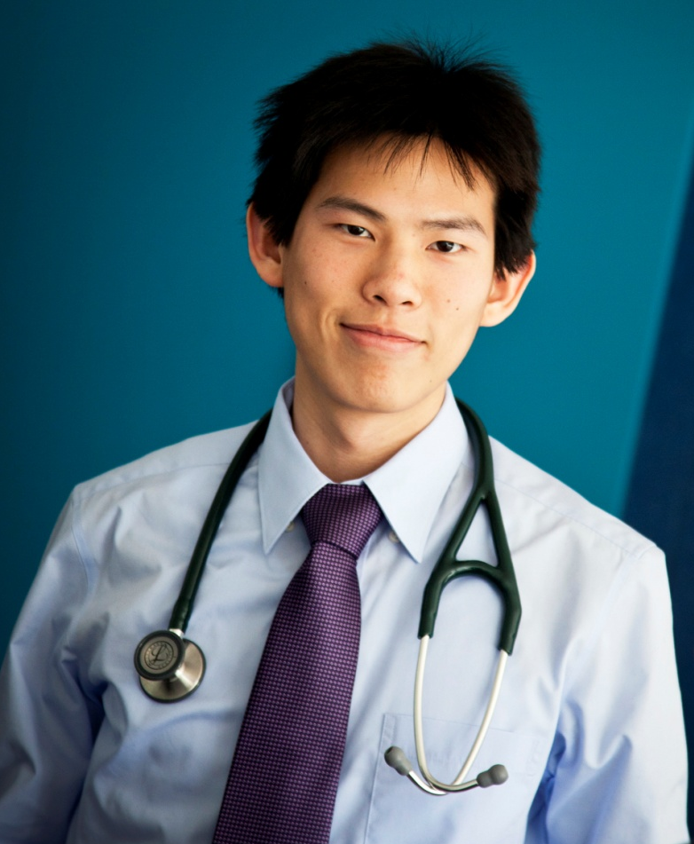
CONTEXT
WHO
Year 2 Medicine (undergraduate)
WHAT
Studying Infectious Diseases
WHEN
Session 2H (2nd half of the year)
NORMAL TEACHING ACTIVITIES
Lectures, Problem Based Learning, Clinical Skills, Practicals

Slide 4
Where are all the students?
Is this the best use of the lecturer or student’s time?

Slide 5
THE FLIPPED CLASSROOM
What is a “flipped classroom”
Using videos or podcasts to shift instruction out of the classroom and move problem solving back into the classroom
Out of class
Lecture as video or podcast
In class
Discussion and problem solving activities

Slide 6
THE FLIPPED CLASSROOM
Traditional classroom
Teacher lectures
Students go home to look at problems for homework
Flipped classroom
Teacher teaches at home (e.g. video/s)
Students take notes at teachers pace
Students take notes at their own pace
Students come to class to apply their knowledge to new problems

Slide 7
THE FLIPPED CLASSROOM
What does a flipped classroom look like?
This may look a little different in every class, this may look a little different every year…

Slide 8
Overall learning design for the Clinical Classrooms

Slide 9
LEARNING DESIGN
3-5 lectures
1-2 week
Infectious Disease lectures online
Group readiness quiz
Group discussion questions
Clinical classrooms
(1 to 2 hours)

Slide 10
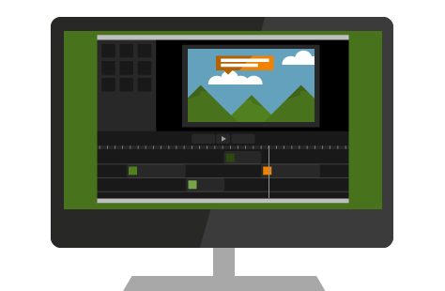
TECHNOLOGY
1) Camtasia® – lecture recording technology

Slide 11
TECHNOLOGY
2) Blackboard - University LMS

Slide 12
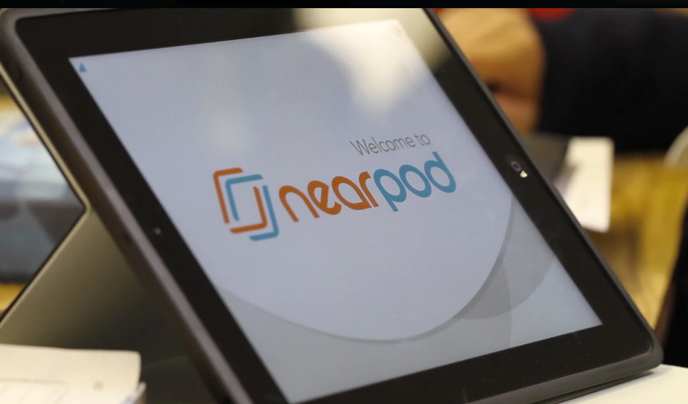
TECHNOLOGY
3) Nearpod
can use PowerPoint slides
Controls the student’s screen
Across Platforms
The instructor can share student responses for discussion with the whole class.

Slide 13
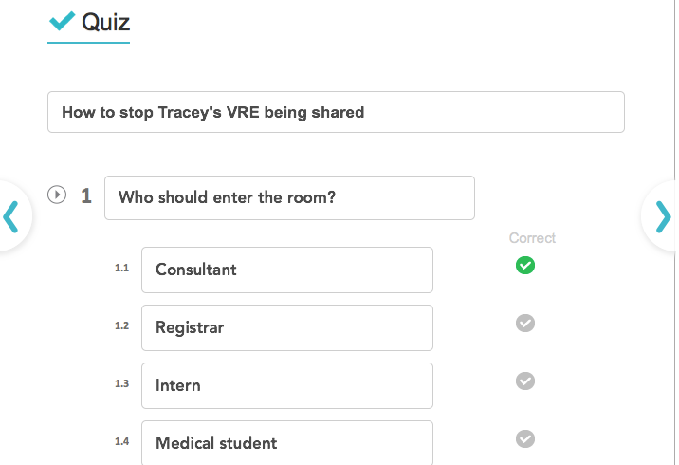
What did a clinical classroom look like?

Slide 14
Evaluation of the Clinical Classroom

Slide 15
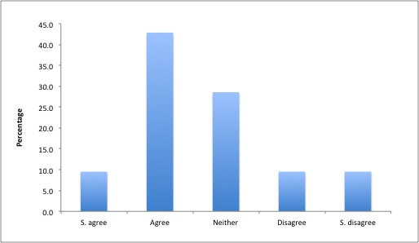
“The online lectures were preferable to face-to-face lectures on the same topic”

Slide 16
“The online lectures were preferable to face-to-face lectures on the same topic”
It was good that it was split up into little chunks of information
Short duration allows watching some in between other activities

Slide 17
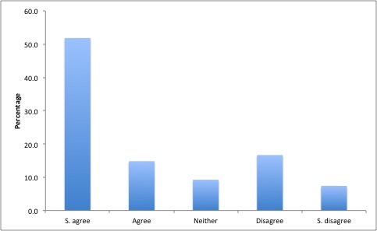
Making the online modules consist of small segments was better than having it as a recording of an entire lecture”

Slide 18
Making the online modules consist of small segments was better than having it as a recording of an entire lecture”
The ~approx 20 mins/30 slide lectures were good length, 5 min lectures seemed very short.
10 minute modules are too short - 20-30 minutes would be better

Slide 19
Technology
The answers and the lecture slides used on that day should be uploaded as that would be beneficial for review purposes.
It would be more helpful if we had access to practise questions and answers at home to supplement the clinical classroom, because sometimes in the tutorial the answers to questions are skimmed over and I would like more time to revise the scenarios for exams
Nearpod
Students can’t return to the class to review their work
Limited activities to quiz, discussion and draw activites
Sharing a screen for group work was unpopular
Controlling screens was sometimes frustrating
Please give us more time to answer questions or give us warning when the questions are being taken down as sometimes we are in the middle of discussions when the questions are taken down

Slide 20
Staff reflections
Camtasia
Worked well
Blackboard
Could deliver online lectures in a sequence
Nearpod
Attractive delivery
Good control of pace
Able to deliver quiz questions and discussion questions
Student’s need access to class for revision
Student’s need to see the activities on their own screen
Some activities can be done at home

Slide 21
Staff reflections
Time:
It was a time consuming process for the staff
For every hour of online lecture that was recorded (and there was approximately 19 hours of recording) an extra 60 or more minutes was needed for the preparation of the lecture for recording
The clinical classrooms were an additional time cost to prepare and required careful planning for their preparation

Slide 22
Future directions
Using LAMS to run the clinical classrooms
sequencing of video and questions in one place,
a record of student answers that are accessible after the student session,
the ability to track the students progress through all of the activities,
the ability for groups of students to chose a representative “leader” to answer questions, while still being able to participate in the activities,
the ability to use other activities such as mind-mapping and
the ability to branch the different groups into different activities.

Slide 23
Future directions
Disadvantages to using LAMS to run the clinical classrooms
Lecturers would not be able to upload PowerPoint presentations straight into LAMS
Would not be able to control the student screens

Slide 24
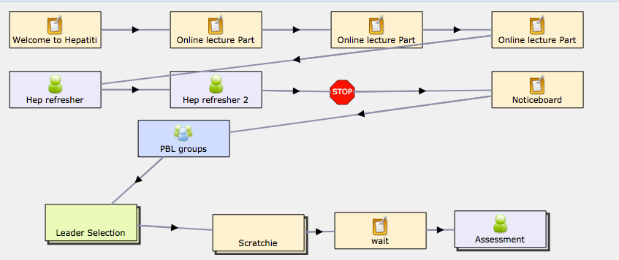
Future directions

Slide 25
Questions?

